Slide 1
Web Scraping
Find unique data through immense suffering

Slide 2
Two ways to get data from the internet
...and how (un)happy they’ll make you
Pretend to be human
Web scraping
:(
I WANT THIS SITE’S DATA FOR MY DATA SCIENCE PROJECT!!!!!1!
Someone has created a Python wrapper
:)
Ask nicely
APIs
I need to write the request
:|

Slide 3
The rewards
Applications of web scraping
Market & product research (brands, products, prices, reviews… of your competitors!)
Lead generation (find people that might be interested in your product!)
Keyword research (what is people looking for?)
“People Analytics” (HR/Talent research: job descriptions, skills, offers…)
Science (stuff that’s not present in official records or traditional datasets: subletting apartments, drug use, people’s language & beheavior...)
Stock Analysis (using data in the web to forecast)
Media Gathering & Analysis
Lots of cool personal projects: what websites do you like?
Notes:
Market & product research (brands, products, prices, reviews… of your competitors!)
Lead generation (find people that might be interested in your product!)
Keyword research (what is people looking for?)
“People Analytics” (HR/Talent research: job descriptions, skills, offers…)
Science (stuff that’s not present in official records or traditional datasets: subletting apartments, drug use, people’s language & beheavior...)
Stock Analysis (using data in the web to forecast)
Media Gathering & Analysis
Lots of cool personal projects: what websites do you like?

Slide 4
Is it legal?
Pa k kieres saber eso jaja saludos
It depends on the site, on what you do with the scraped data.
As legal or as illegal as downloading data manually from the internet: there might be copyright issues.
You probably want good legal advice if you have to make money with it.
Scraping public government web sites & scraping for personal use is generally safe.
Some websites have a file called “robots.txt” stating whether or not you should scrape them. That does not have legal implications, it’s more an ethical thing.

Slide 5
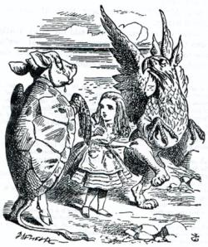
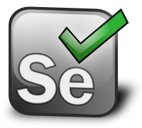

The tools
Beautiful Soup
Selenium
User friendly
Popular (lots of tutorials, stackoverflow posts…)
Slow
Fast
Requires no dependencies
Not user friendly (set up pains)
Versatile (also works for testing)
Can scrape JavaScript content
Difficult
Slow

Slide 6
HTML
All these things are HTML tags
<html>
<body>
<div>
<p>Hello class!</p>
<p>Wave into the cam if you already know html</p>
</div>
<p>Wow you are so knowledgeable</p>
</body>
</html>

Slide 7
Tags can have attributes
This tag has 2 attributes
<div id=“unique-id” class=“some-class”>
...div element contents…
</div>
<a href=“https://www.reddit.com”>
Don’t click this link if you want to stay productive
</a>
The href attribute contains a link
HTML tags reference: https://www.w3schools.com/TAGS/default.ASP

Slide 8
Chrome dev tools
On Google Chrome, press CTRL + SHIFT + I

Slide 9
BeautifulSoup
import requests
from bs4 import BeautifulSoup
# download the webpage
url = “https://www.the-website-you-wanna-scrape.com”
page = requests.get(url)
# parse the html
soup = BeautifulSoup(page.content, 'html.parser')
# print the formatted html
print(soup.prettify())

Slide 10
How to search content
# using HTML tags
soup.find_all(“div”, class_=“class-name”)
# using CSS Selectors
soup.select("body div.class-name a")
https://flukeout.github.io/

